Slide 1
The Great Acceleration
By Will McWilliams

Slide 2
Intro
Is there a correlation between carbon emissions and climate change. The amount of carbon emitted has effected the rate at which the climate changes.
What countries are the most responsible for the carbon emissions.
What industries are producing the most carbon emissions.

Slide 3

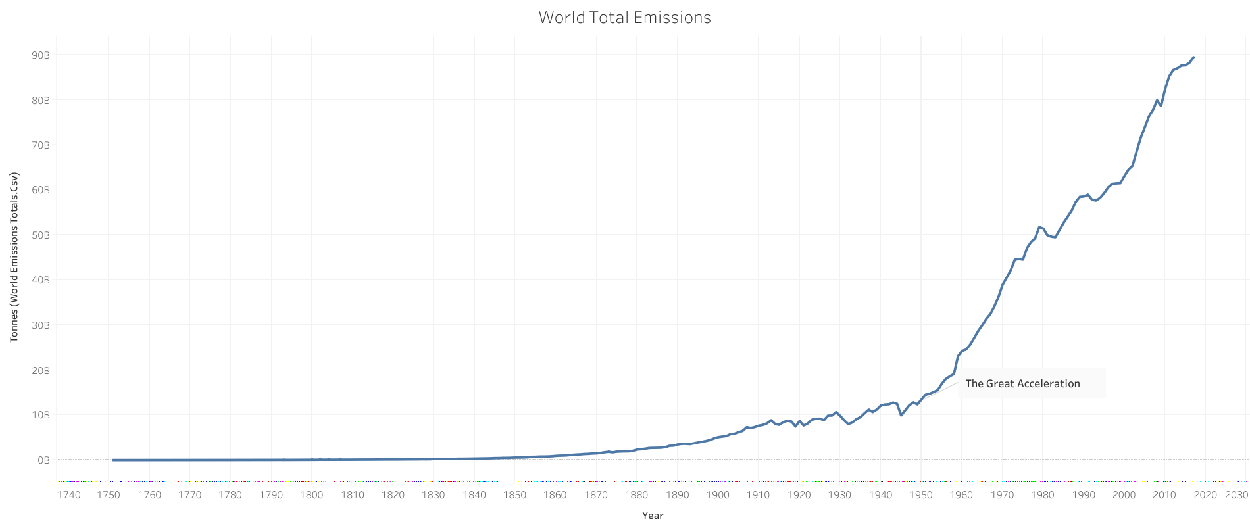

Slide 4
The Great Acceleration
Who? Us!!!!!
What? Dramatic continual and roughly simultaneous surge in growth rate across the globe.
When? Mid 20th century
Where? All over
Why? Population increase,
How? Energy, Transportation, Concrete Manufacturing

Slide 5
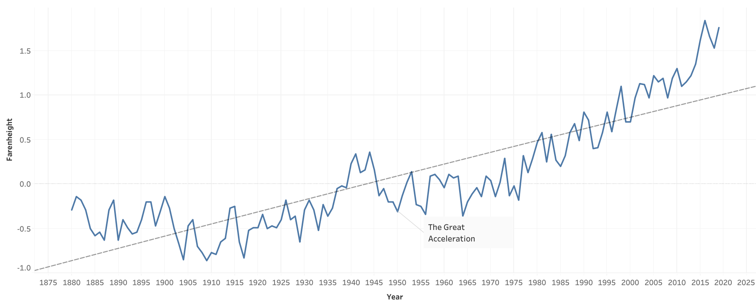
Global Averages (1880-2019)

Slide 6
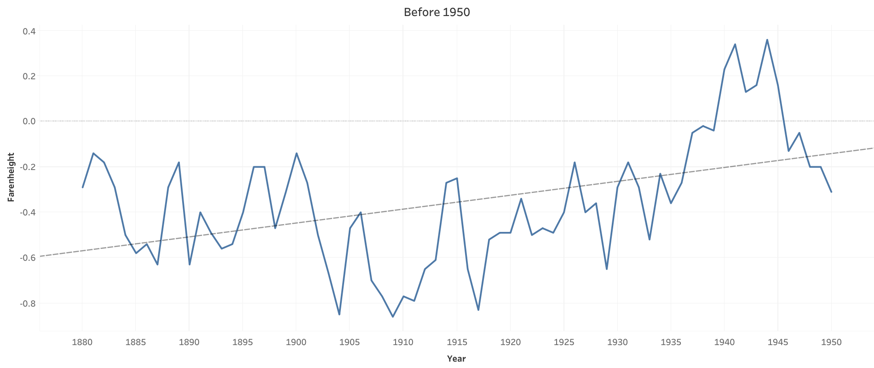
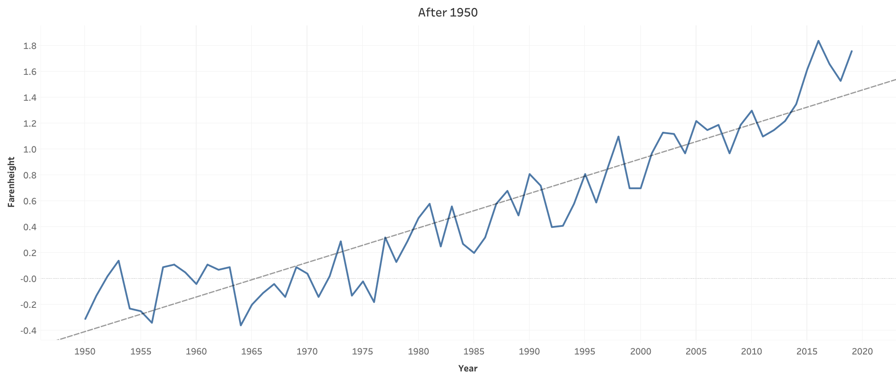
Before and After 1950

Slide 7
Break down of natural disasters
Mention types of nd
Record keeping of nd
Maybe how warm climate effects nd

Slide 8
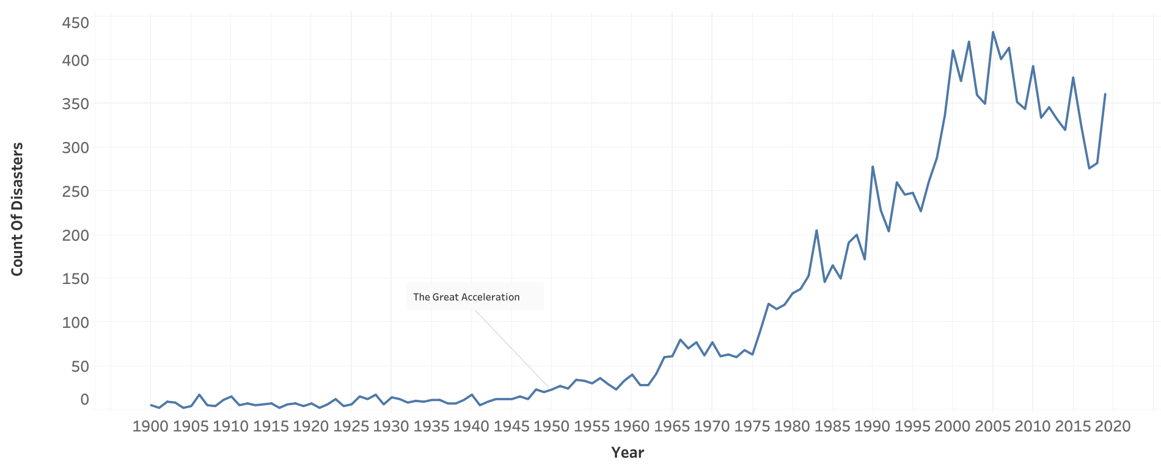
Natural Disasters

Slide 9
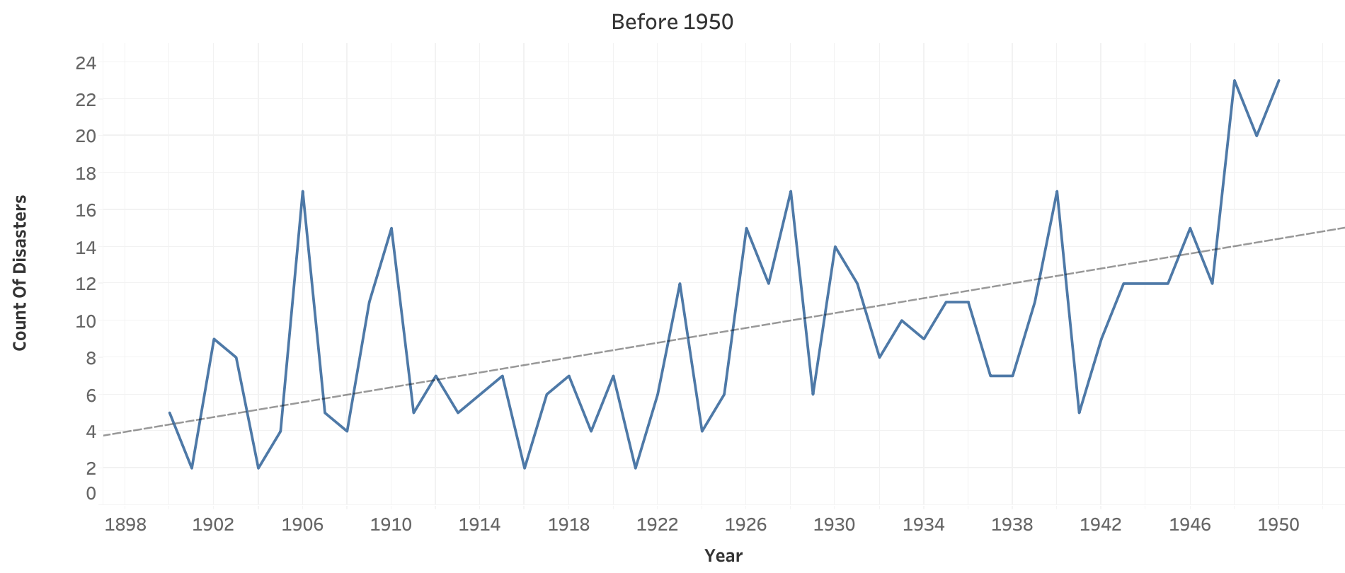
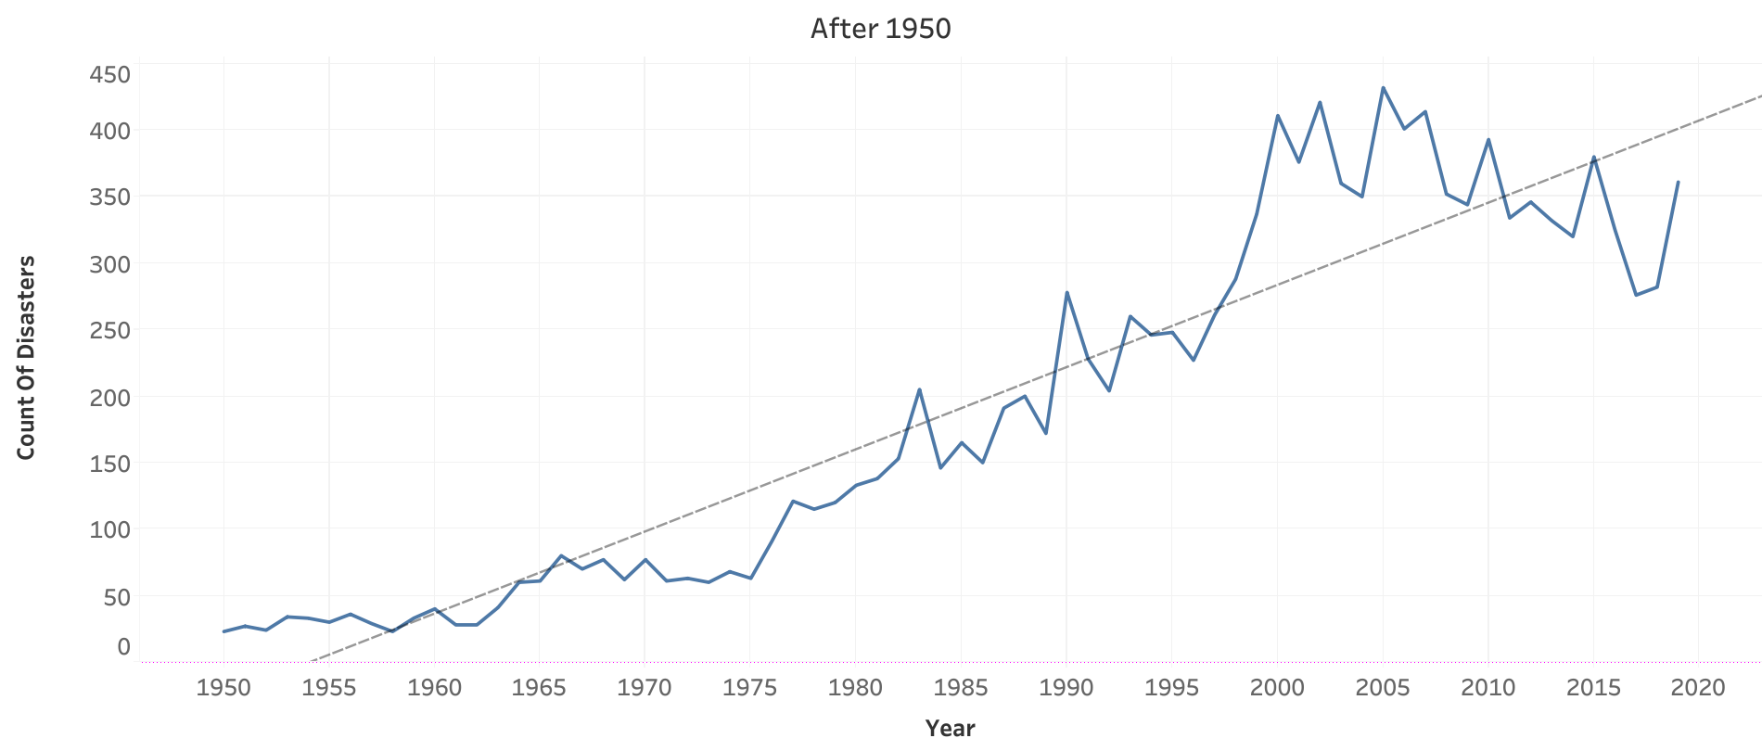
Before and After 1950

Slide 10
Rank of Continents

Slide 11
Top 5 Countries

Slide 12
Green House Gas Inventory
1
2
3
4
5
6

Slide 13
Conclusion
There is a correlation with the timelines
Reiterate the top 5 countries
List off the top industries that contribute the most carbon

Slide 14
Questions?

